Slide 1
Code Obfuscation – Trusted Software Demo
Irdeto

Slide 2

Software Hacking is a Business
Criminals offer many products and services built on top of hacked software¹
The average IoT device is attacked 5,233 times each month²
Compromised IoT devices are a prime target for hackers
Botnet armies can be used for Distributed Denial of Service (DDoS) attacks
IoT devices in critical infrastructure can be ransomed
IoT devices can be used to distribute malware
Hackers use dynamic and static methods to attack IoT devices
Reverse engineer code to find vulnerabilities
Alter code to support hacker‘s objectives
Probe running code to extract secrets (crypto-keys)
€€€
Symantec Internet Security Threat Report 2019-02, page 57
Symantec Internet Security Threat Report 2019-02, page 55

Slide 3
Value of Code Obfuscation
Makes reverse engineering more difficult
Prevents use of debugging tools
Protects against system call hooking
Stops code from running on rooted devices
Hides keys and secrets in software or storage
Protects application / business logic
Protects valuable IP in code
Protects keys, both stored and when used
Prevents hacking / changes to software
Enables software diversity
Software instances are functionally equivalent, but code differs
Reduces scale of an attack, and resets hacker progress
Integrity validation
Security renewability
Debugger disarming
Security telemetry
Code cloaking
White-box cryptography
File & data encryption

Slide 4



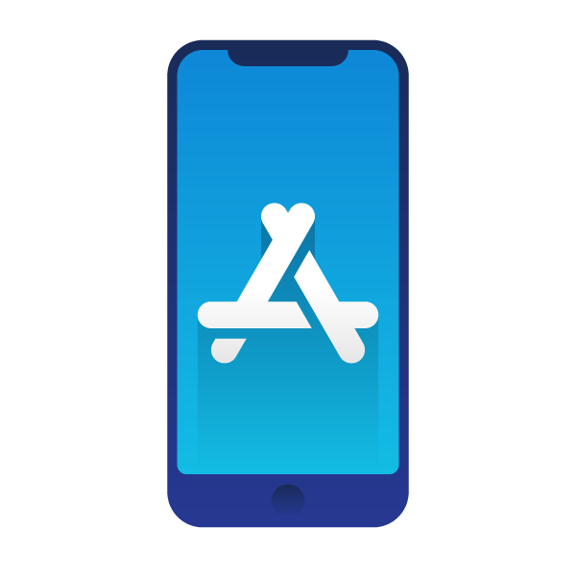
Simplifying Code Obfuscation
“Good” code obfuscation is an art
Must master multiple tools with steep learning curves
Requires software, security, and crypto skills
Time consuming to fine-tune performance vs footprint
Makes sense for security-critical and complex software
Less feasible for simpler IoT software and Apps
Irdeto Trusted Software
On-line service that automatically applies code obfuscation
Uses AI to identify security-sensitive code in Apps
Applies security using Cloakware® Software Protection
Beyond SotA: Trusted Software is the first (and currently only) obfuscation tool that makes use of machine learning to automatically apply protection to code
Trusted Software
App-store ready
unprotected app
App-store ready
protected app

Slide 5
Zero Touch Protection / Ease of Use

Slide 6
Demo Video

